Slide 1
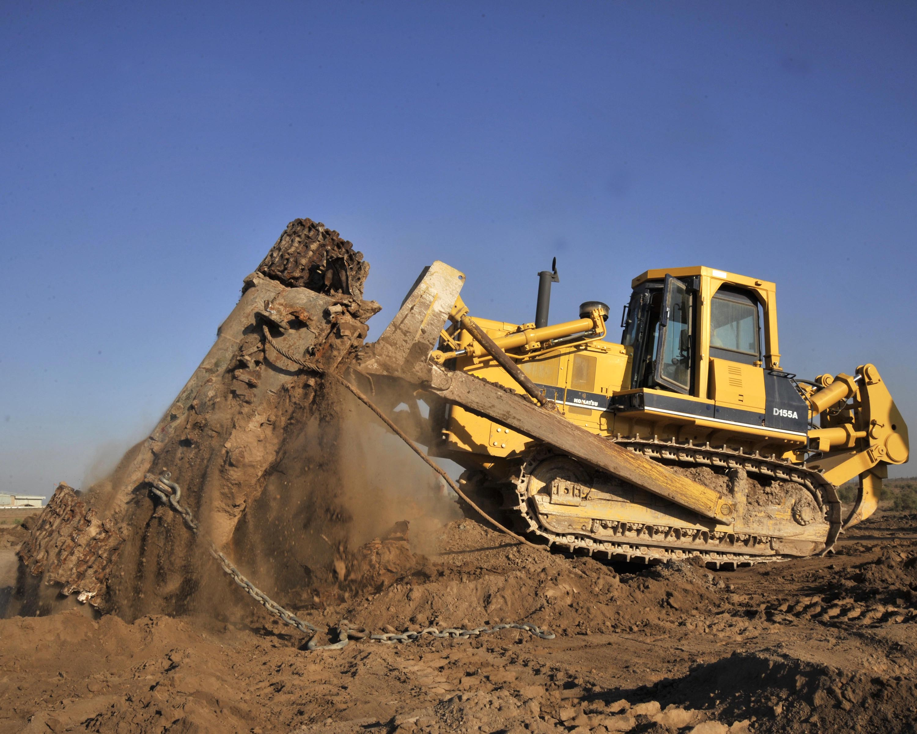
Servers are like Bulldozers
2 ways to use R on a Virtual Machine (VM)
Clark Fitzgerald
Analyst - Cisco Business Intelligence
Notes:
Grateful to be here
Family does construction
Want to be statistician- graduated from Berkeley last year, took GRE’s this morning
R is like a home tractor
R on a server is like a bulldozer- powerful capabilities
Why buy a bulldozer?

Slide 2
Rent the Bulldozer!
Notes:
You can have complete control over your VM
Pay only while you use it

Slide 3
Economics
Cool new server: Couple thousand dollars
Electricity in Bay Area: $0.22 per kWh
800 Watts => $0.18 per hour for electricity
Amazon 2 XL standard instance:
30 GB memory
8 Cores
$0.18 per hour for spot instance
Notes:
Server: http://www.amazon.com/Lenovo-ThinkServer-2594A9U-E5-2620-Processors/dp/B00BGFMFGU/ref=sr_1_3?s=pc&ie=UTF8&qid=1380547414&sr=1-3
Electricity: http://www.bls.gov/ro9/cpisanf_energy.pdf
Amazon Pricing: http://aws.amazon.com/ec2/instance-types/
http://aws.amazon.com/ec2/pricing/#spot

Slide 4

Case 1: Teaching
Good for beginners
10 students at a time
VM with 2 cores, 4 GB memory
Notes:
Students can access Rstudio from web browser
No need to install- makes it less intimidating, lowers the bar
Create Linux users with standard names

Slide 5
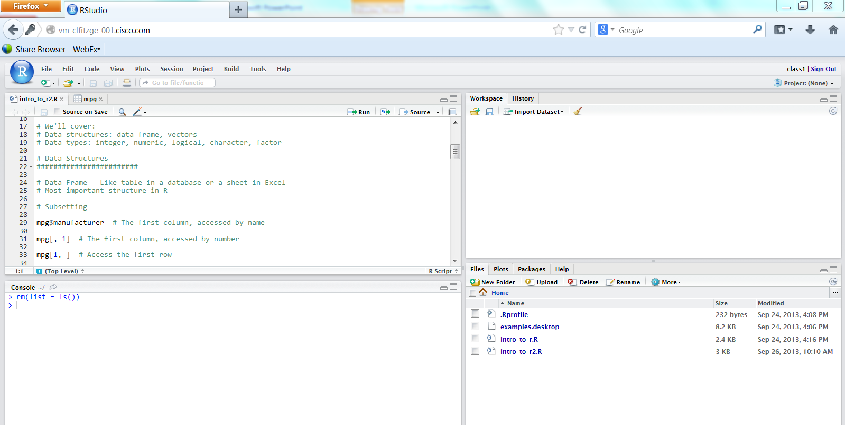
Case 1: Teaching
Notes:
Push the same script out to each user’s file directory
Set permissions so they can read the script but not save changes
Should be using this along with a presentation tool- projector or Webex

Slide 6
Case 2: Automation
Run a program on a regular basis
Used AWS micro instance for free
Example: Build a time series of exchange rate data
data <- readHTMLTable("http://www.x-rates.com/table/?from=USD&amount=1")
…
write.table(row, "/home/shared/barug_oct13/hourly_rate.csv",
append = TRUE, quote = FALSE, sep = ", ",
row.names = FALSE, col.names = FALSE)
Linux shell ~$crontab -e
0 * * * * sudo R CMD Batch /home/shared/barug_oct13/get_conv_rate.R

Slide 7
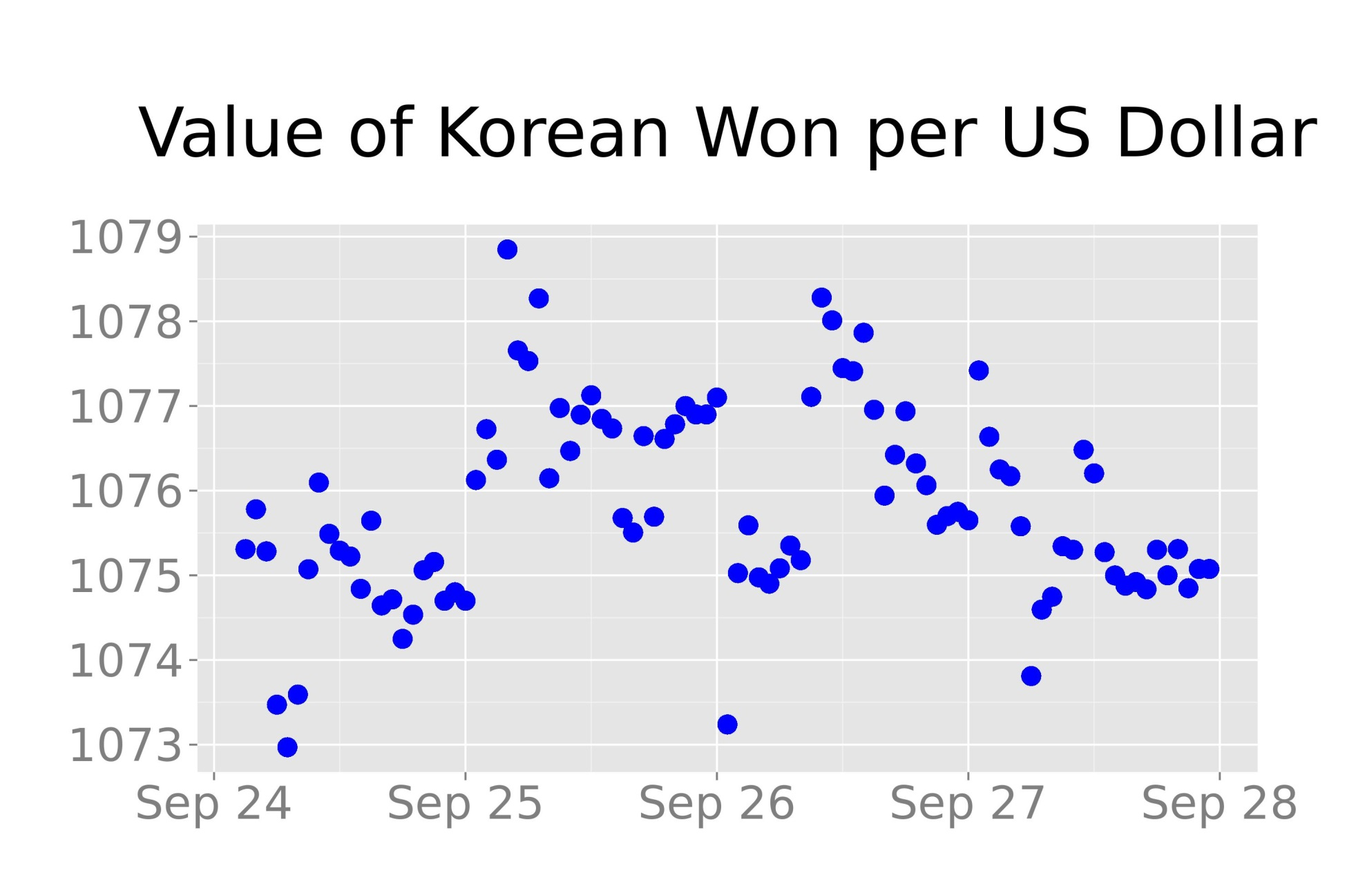
Case 2: Automation
Notes:
require(ggplot2)
require(grid)
hourly <- read.csv("/home/shared/barug_oct13/hourly_rate.csv",
col.names = c("time", "rate"),
colClasses = c("POSIXct", "numeric"))
conv.rate <- ggplot(hourly, aes(time, rate)) +
geom_point(size = 5, color = "blue") +
ggtitle("Value of Korean Won per US Dollar") +
theme_gray(30) +
theme(axis.title.x = element_blank(), axis.title.y = element_blank()) +
theme(plot.margin = unit(c(3, 2, 1, 1), "cm")) +
theme(plot.title = element_text(vjust= 5))
ggsave(conv.rate, file = "conv_rate.jpg", width = 10, height = 6.5)

Slide 8
Details:
Case 3- High performance computing
Amazon Web Services Elastic Compute (AWS EC2)
Get started with Louis Aslett’s site
Can scale up arbitrarily large

Slide 9

Questions?

Slide 10
Links:
Everything can be found on my blog:
http://datalearner.wordpress.com/
http://www.louisaslett.com/RStudio_AMI/
Electricity: http://www.bls.gov/ro9/cpisanf_energy.pdf
Amazon Pricing: http://aws.amazon.com/ec2/instance-types/
http://aws.amazon.com/ec2/pricing/#spot

